Slide 1
Operating System

Slide 2
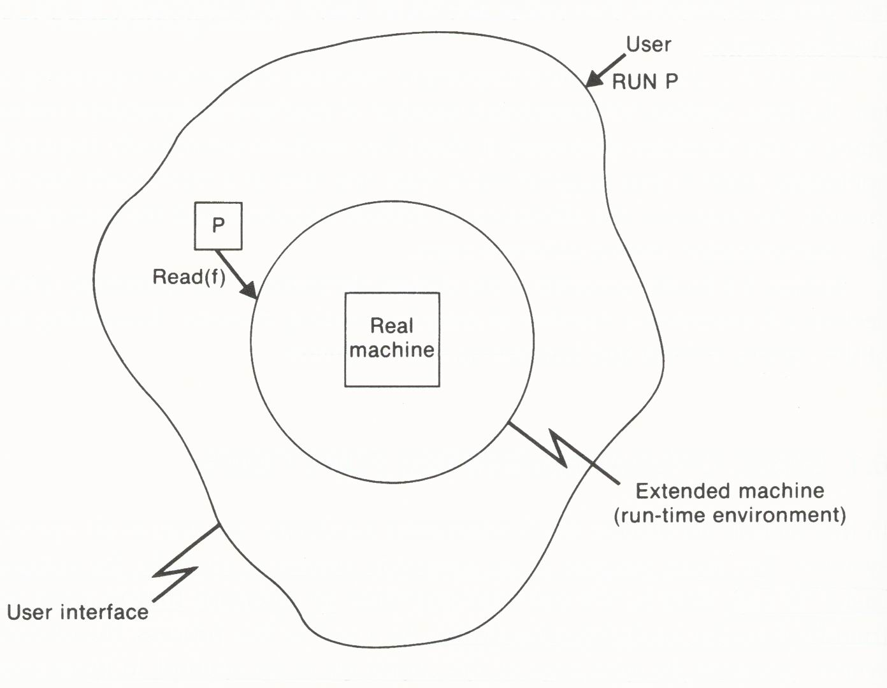
Operating System
Main goal of OS:
  Run programs efficiently
  Make the computer easier to use
    Provide a user-friendly interface
  Improve the efficiency of hardware utilization
    Manage the resources of the computer

Slide 3
Types of Operating Systems
Classifying OS
  Number of users that OS can support at one time
    Single-job system
    Multiprogramming system
    Multiprocessor system
  Access provided to a user
    Batch processing system
    Time-sharing system
    Real-time system
  Organization of a network of computers
    Network operating system
      User is aware of the existence of the network
    Distributed operating system
      User views the entire network as a single system

Slide 4
Run-Time Environment
OS supports a run-time environment for user programs:
  Service routines for use during program execution
  Facilities for resource management
Service routines can be thought of as defining an extended machine for use by programs
The extended machine is easier to use and is less error-prone.
User programs can call operating system functions by
  Referring directly to fixed locations in memory
  Using some special hardware instruction such as a supervisor call (SVC) which generates an interrupt.

Slide 5
Supervisor Mode
Generation of an interrupt causes the CPU to switch from user mode to supervisor mode.
In supervisor mode, all machine instructions and features can be used.
In user mode, the use of privileged instructions is restricted. The only way is to make use of the services provided by the run-time environment.

Slide 6
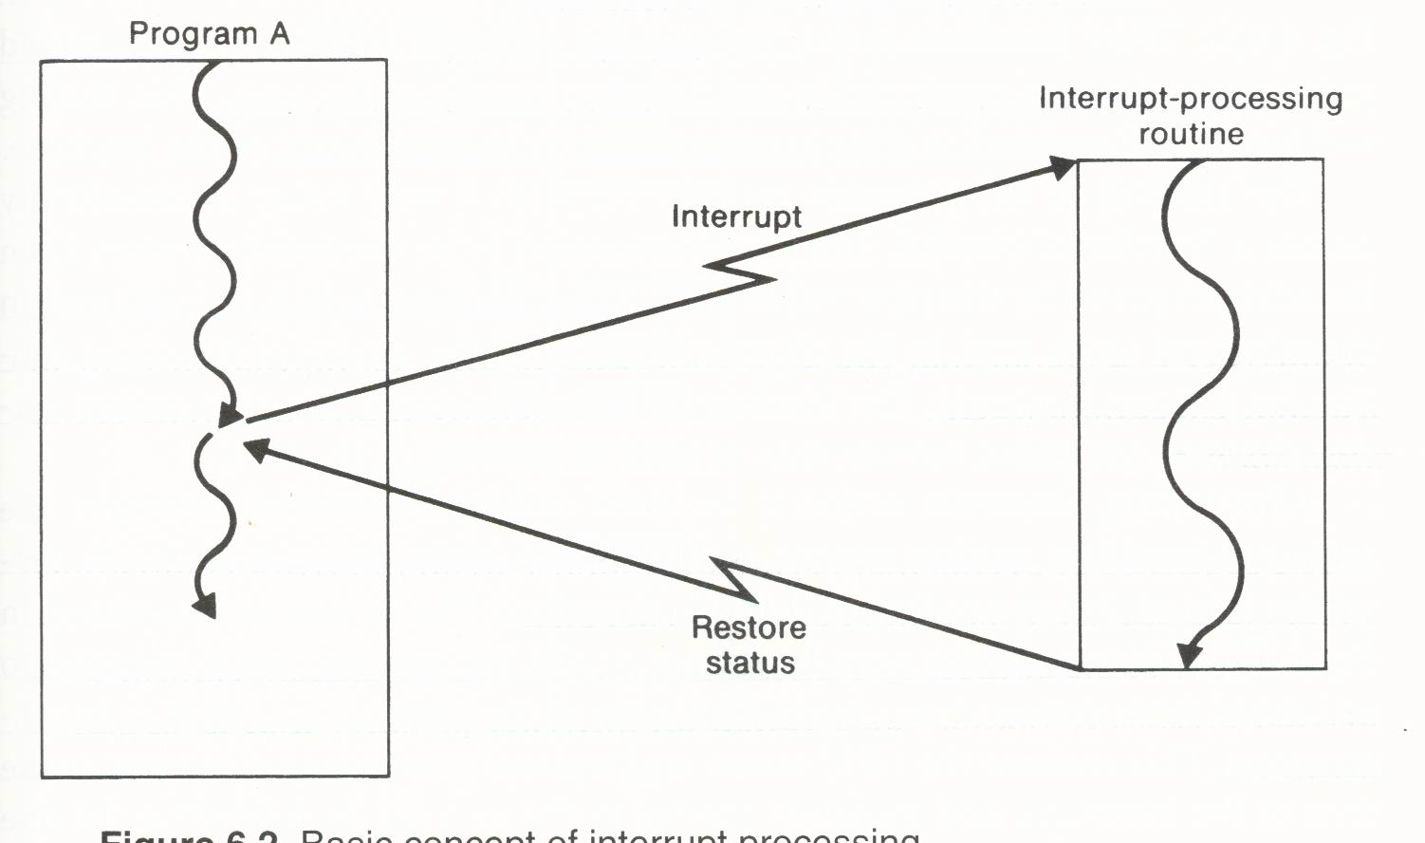
Interrupt Processing
An interrupt is a signal that causes a computer to alter its normal flow of instruction execution.
The interrupt automatically transfers control to an interrupt-processing routine (interrupt handler) that is usually a part of OS.
Generation and processing of the interrupt may be completely unrelated (asynchronous) to the running program.

Slide 7
SIC/XE Interrupts
Four classes of SIC/XE interrupts
  Class I: SVC interrupt
    Generated when a program use a SVC to request OS functions.
  Class II: program interrupt
    Generated by some conditions that occurs during the program execution, e.g., divide by zero.
  Class III: timer interrupt
    Generated by an interval timer containing a register that can be set by the privileged instruction STI.
  Class IV: I/O interrupt
    Generated by an I/O channel or device to signal the completion or error condition of some I/O operations.

Slide 9
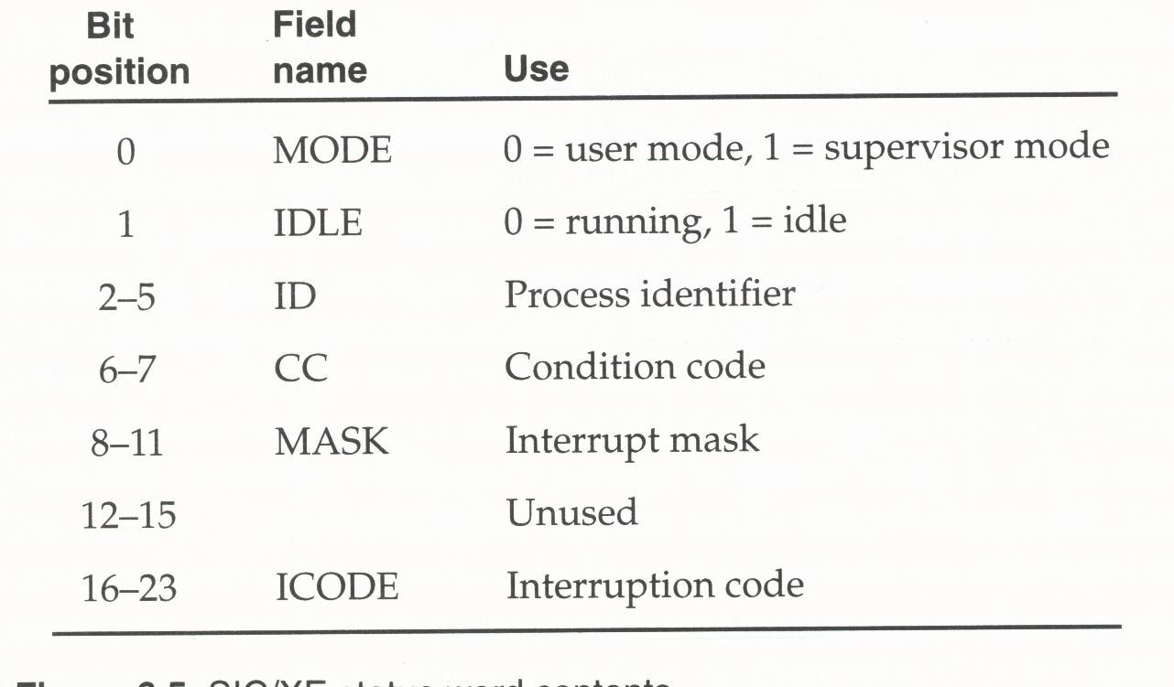
Status Word (SW) of SIC/XE

Slide 10
Interrupt Mask
MASK is used to control whether interrupts are allowed.
This control is necessary to prevent loss of the stored processor status information by prohibiting certain interrupts from occurring while the first one is being processed.
MASK contains one bit for each class of interrupt.
Pending interrupts: masked (inhibited or disabled) interrupts are not lost but saved temporarily.
Masking of interrupts is under control of OS
  Set all the bits in MASK to 0 when processing the interrupt, which prevents the occurrence of any other interrupt.
  Is it necessary to do so?

Slide 11
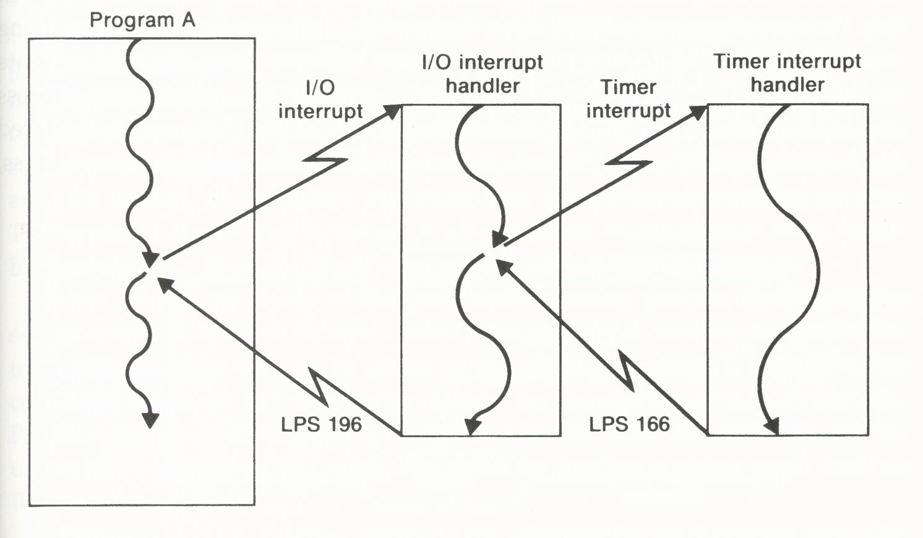
Nested Interrupts
Each class of interrupt is assigned an interrupt priority: SVC > program > timer > I/O
The MASK field is set so that all interrupts of equal or lower priority are inhibited; however, interrupts of higher priority are allowed to occur.

Slide 12
Process Scheduling
A process (task) is a program in execution.
In a multiprogramming system, process scheduling is the management of the CPU (CPUs) by switching control among the various competing processes according to some scheduling policy.
During the existence, the process can be in one of three states:
  Running: actually executing the instructions using the CPU
  Blocked: waiting for some event to occur
  Ready: waiting as a candidate to be assigned the CPU

Slide 13
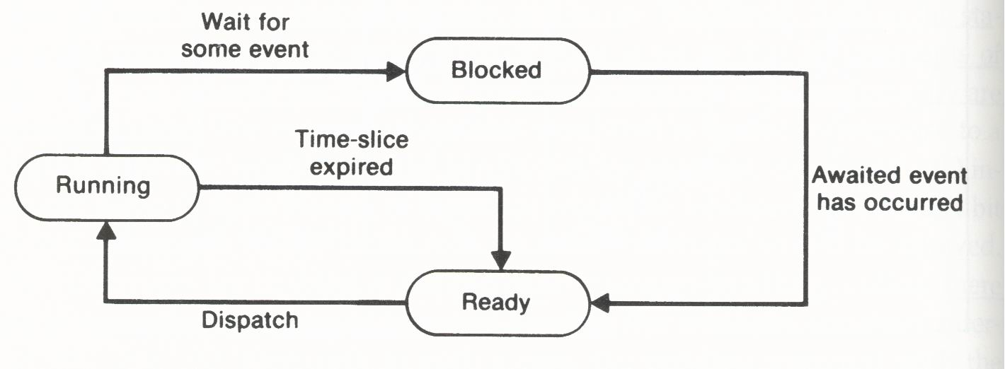
Process State Transitions
destroy
create
Time-slice: a maximum amount of CPU time the process is allowed to use before giving up control.
Dispatching: the selection of a process in ready state and the transfer of control to it.
Process status block (PSB): where the status information for each process is saved by the OS
  Process state (running, ready, or blocked)
  Registers (including SW and PC)
  Variety of other information (e.g., system resources used by the process)

Slide 14
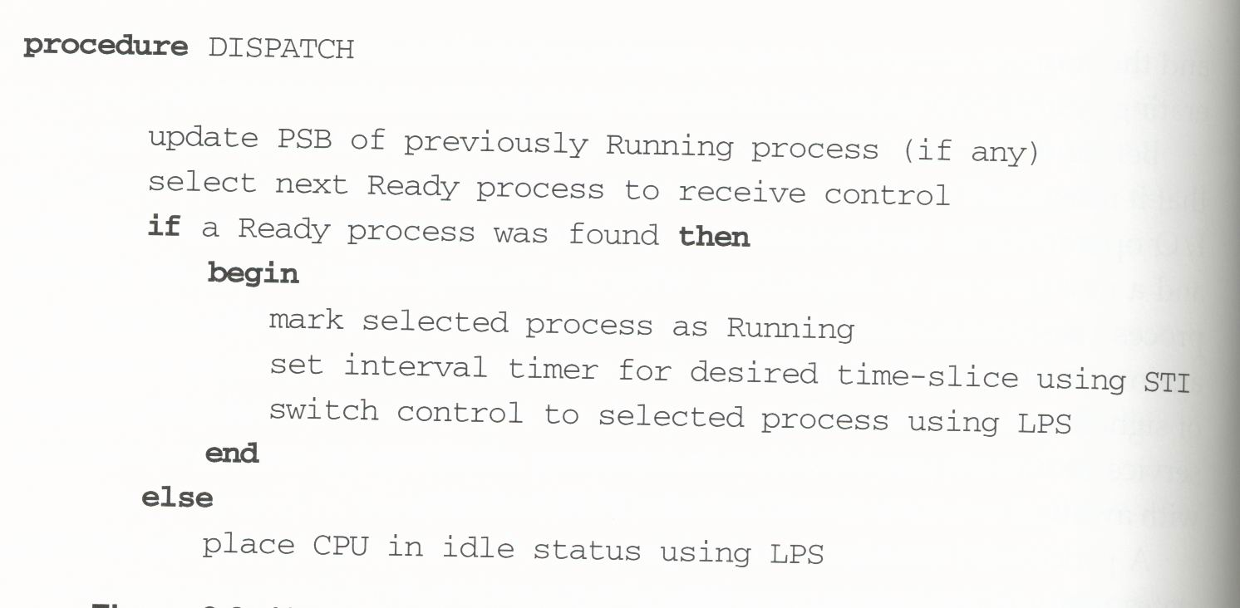
Dispatcher Algorithm
How to find it?

Slide 15
Dispatcher Algorithm
Process selection policy:
  Round robin
    Treat all processes equally and give the same length of time-slice to all the processes.
  Priority scheme
    Priorities can be
      predefined based on the nature of the user job
      assigned by the OS
      allowed to be vary dynamically, depending on the system load and performance.
    Preemptive scheduling: a higher-priority process can seize control from a lower-priority process that is currently running.

Slide 16
Mutual exclusion
Deadlock
Synchronization
Starvation

Slide 17
I/O Supervision
SIC: CPU is involved with each byte of data being transferred to or from I/O device
  Test the status of the I/O device
  Read-data instruction
SIC/XE: I/O are performed by special hardware, simple processors known as I/O channels
  Start I/O (SIO) instruction
    Channel number
    Channel programs (a series of channel commands)
  The channel generates an I/O interrupt after completing the channel program.

Slide 18
Programmed I/O (Polling I/O)
  CPU busy-waiting
Interrupt-driven I/O
Direct Memory Access

Slide 19
I/O Process of OS
User Programs
I/O completion
notification
I/O request
Operating System
I/O interrupt
I/O operation control
I/O Channels

Slide 20
Management of Real Memory
Any OS that supports more than one user at a time must provide a mechanism for dividing central memory among the concurrent processes.
Level of multiprogramming is limited only by the number of jobs that can fit into central memory.
Many multiprogramming and multiprocessing systems divide memory into partitions, with each process being assigned to a different partition.
  Fixed partitions: predefined in size and position
  Variable partitions: allocated dynamically according to the requirements of the jobs being executed

Slide 21
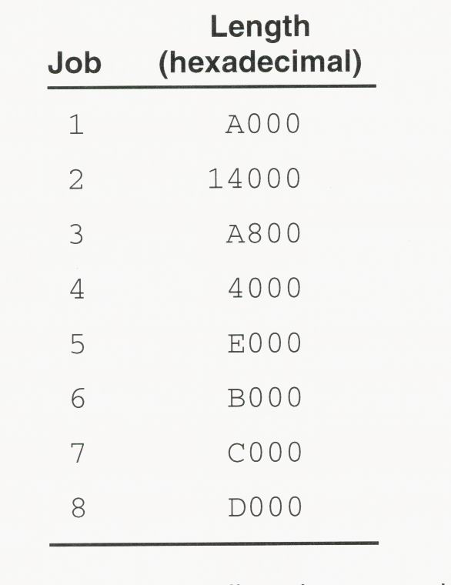
User Jobs for Memory Allocation Examples

Slide 22
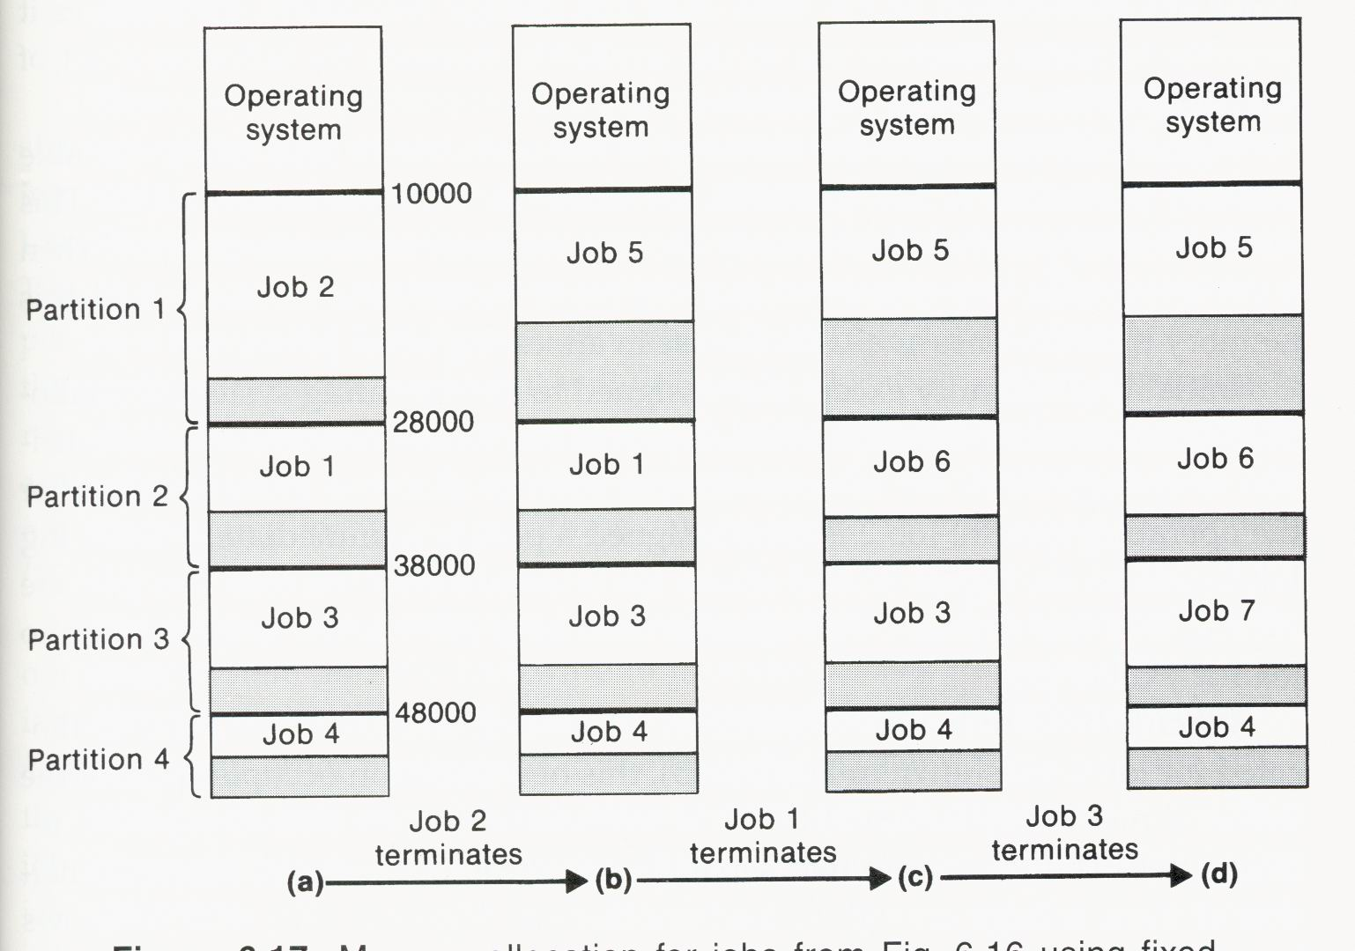
Fixed Partition Example

Slide 23
Strategy of Fixed Partition
Allocation scheme:
  load each incoming job into the smallest free partition in which it will fit.
Initial selection of the partition sizes:
  Considerations:
    There must be enough large partitions so that large jobs can be run without too much delay.
    If there are too many large partitions, a great deal of memory may be wasted when small jobs are running.
  Scheme:
    Tailor a set of partitions to the expected population of job sizes

Slide 24
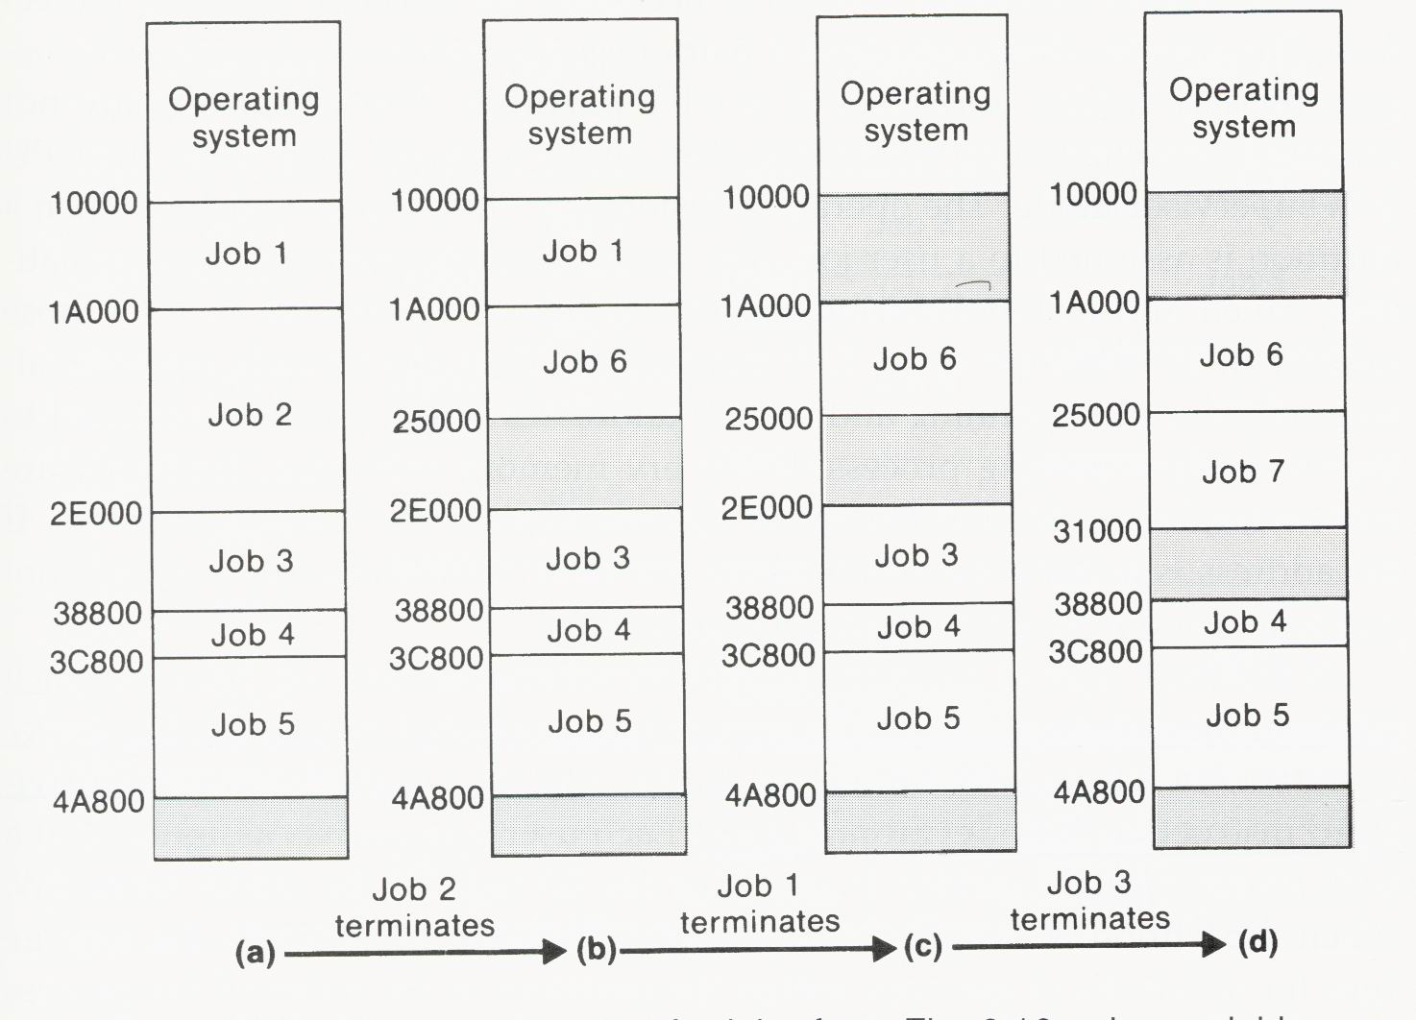
Variable Partition Example

Slide 25
Strategy of Variable Partition
Allocation scheme:
  For each job to be loaded, OS allocates, from the free memory areas, a new partition of exactly the size required.
    OS must keep track of allocated and free areas of memory, usually by maintaining a linked list of free memory areas.
    This list is scanned when a new partition is to be allocated.
      First-fit allocation: the first free area in which it will fit
      Best-fit allocation: the smallest free area in which it will fit
When a partition is released, its assigned memory is returned to the free list and combined with adjacent free areas.

Slide 26
Memory Protection
Memory protection:
  When a job is running in one partition, it must be prevented from reading and writing memory locations in any other partition or in the OS.
Approaches (hardware support is necessary)
  Using a pair of bounds registers that contain the beginning and ending addresses of a job’s partition
    OS sets the bounds registers (in supervisor mode) when a partition is assigned to a new job.
    The values in theses registers are automatically saved and restored during context switching.
    For every memory reference, the hardware automatically checks the referenced address against the bounds registers.
  Using storage protection key

Slide 27
Storage Protection Key in SIC/XE
Each 800-byte block of memory has associated with it a 4-bit storage protection key.
These keys can be set by the OS using the privileged instruction SSK (Set Storage Key).
When a partition is assigned, OS sets the storage keys for all blocks of memory within the partition to the 4-bit process identifier of the process.
For each memory reference by a user program, the hardware automatically compares the process identifier from SW to the protection key for the block of memory being addressed.

Slide 28
Memory Fragmentation
Memory fragmentation occurs when the available free memory is split into several separate blocks, with each block being too small to be of use.
One possible solution: relocatable partitions
  After each job terminates, the remaining partitions are moved as far as possible toward one end of memory.
  Pros:
    More efficient utilization of memory
  Cons:
    Substantial amount of time required to copy jobs
    Problems with program relocation

Slide 29
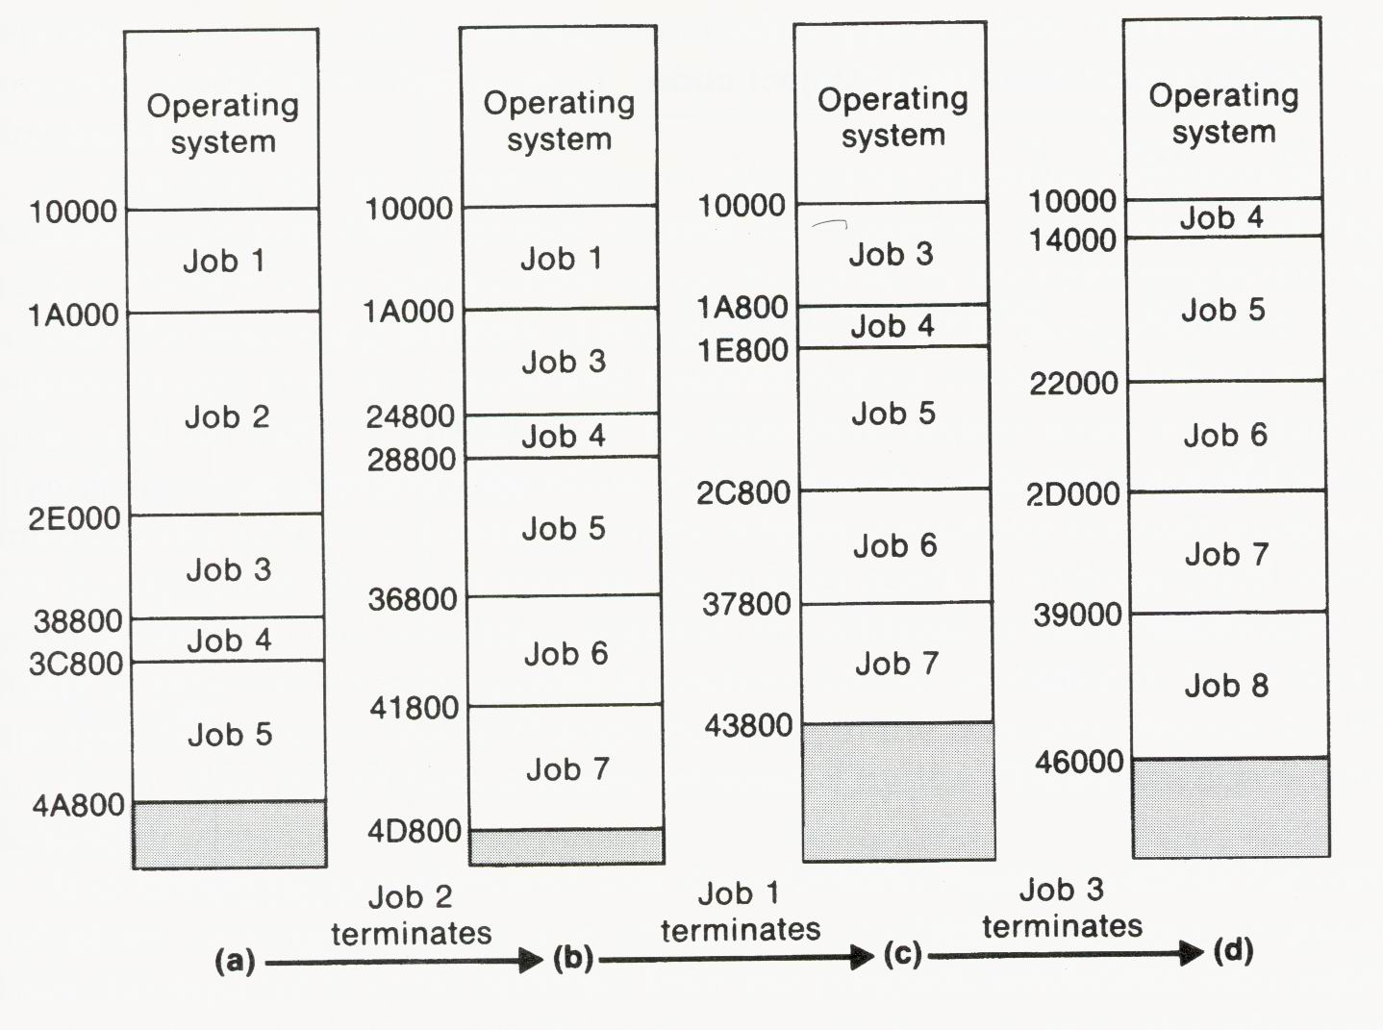
Relocatable Partition Example

Slide 30
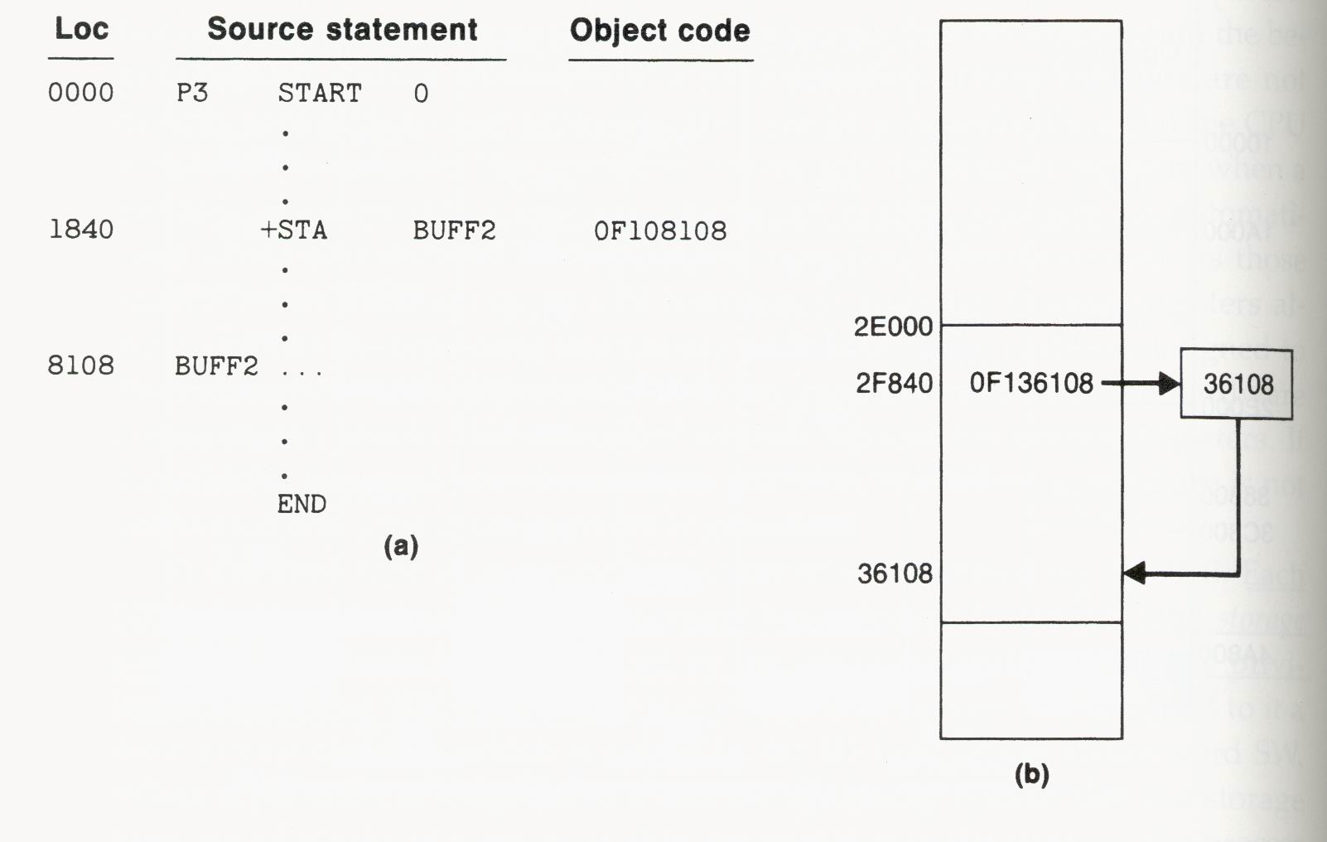
Program Relocation

Slide 31
Relocatable Partitions
Practical implementation of relocatable partitions requires some hardware support: a special relocation register containing the beginning address of the program currently being executed.
  The value of this register is modified when the process is moved to a new location.
  This register is automatically saved and restored during context switching.
  The value of this register is automatically added to the address for every memory reference made by the user program.

Slide 32
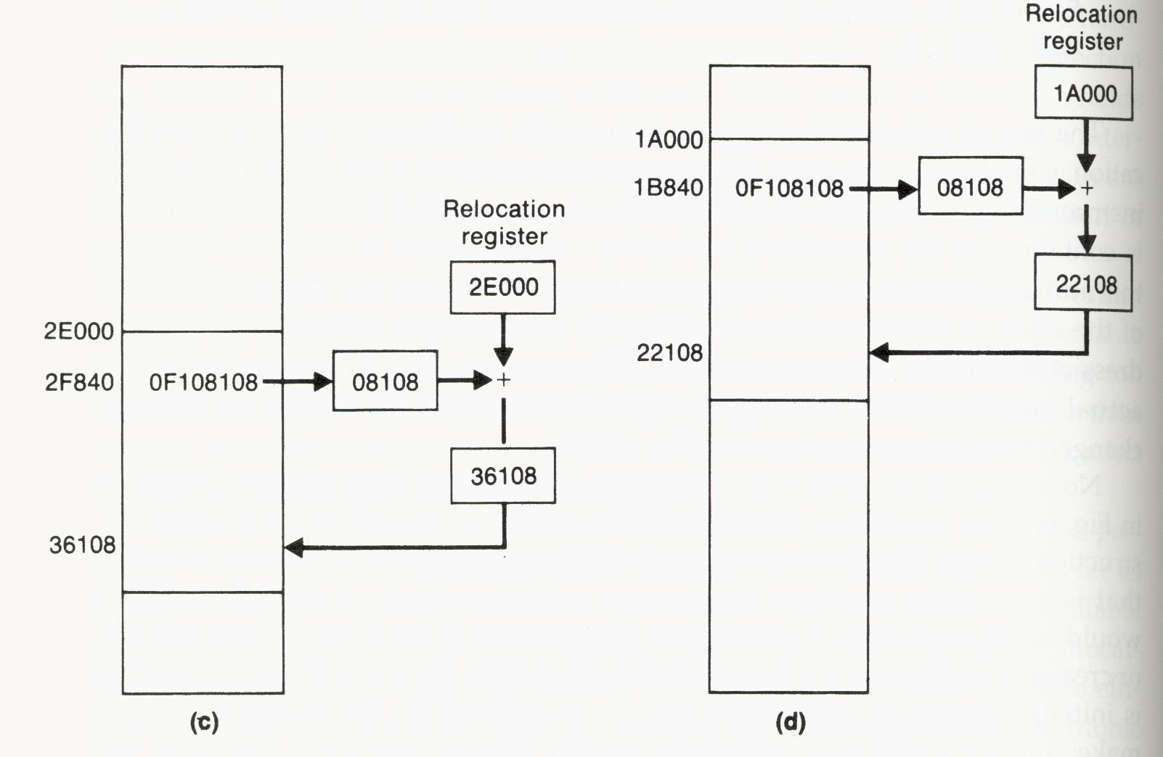
Relocation Register for Address Calculation

Slide 33
Basic Concept of Virtual Memory
A virtual resource is one that appears to a user program to have characteristics that are different from those of the actual implementation of the resource.
User programs are allowed to use a large contiguous virtual memory, or virtual address space.
Virtual memory
  is stored on some external device, the backing store.
  may even be larger than the total amount of real memory available on the computer.
  can increase the level of multiprogramming because only portions of virtual memory are mapped into real memory as they are needed.

Slide 34
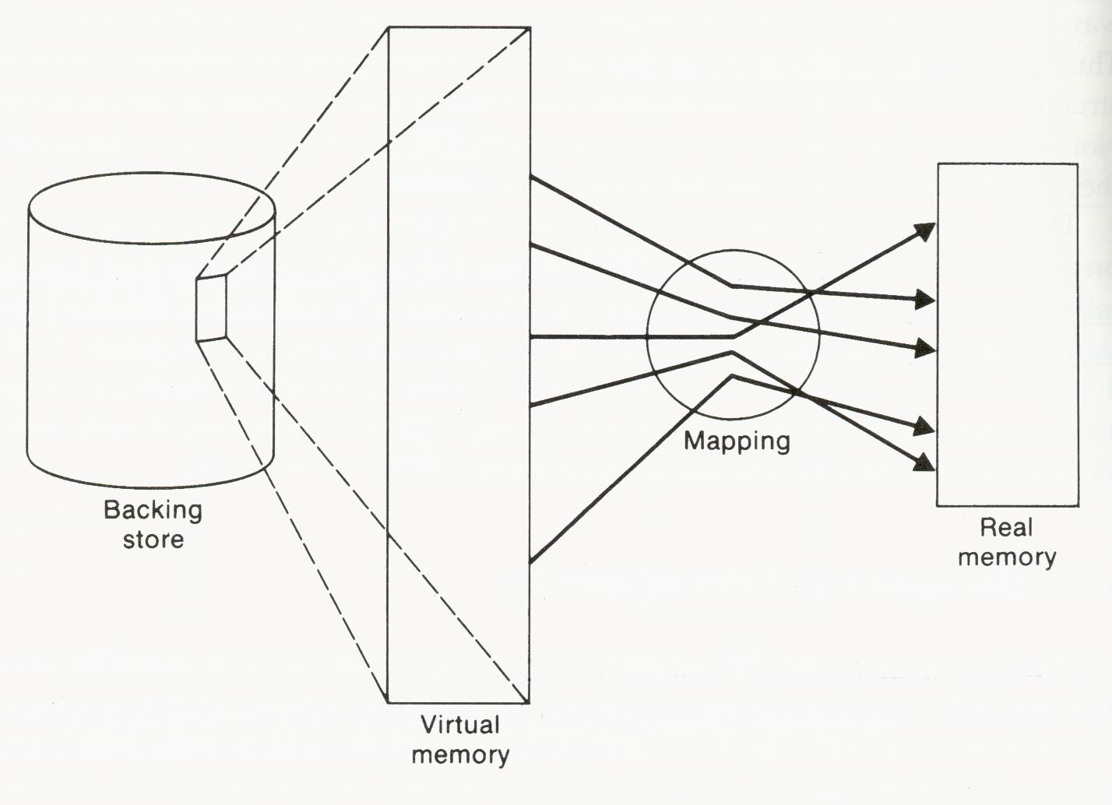
Basic Concept of Virtual Memory

Slide 35
Demand Paging
Demand paging
  One common method for implementing virtual memory.
  Virtual memory of a process is divided into pages of some fixed length.
  Real memory of the computer is divided into page frames of the same length as the pages.
  Mapping of pages onto page frames is described by a page map table (PMT).
  PMT is used by the hardware to convert addresses in a program’s virtual memory into the corresponding addresses in real memory.
  This address conversion is known as dynamic address translation.

Slide 36
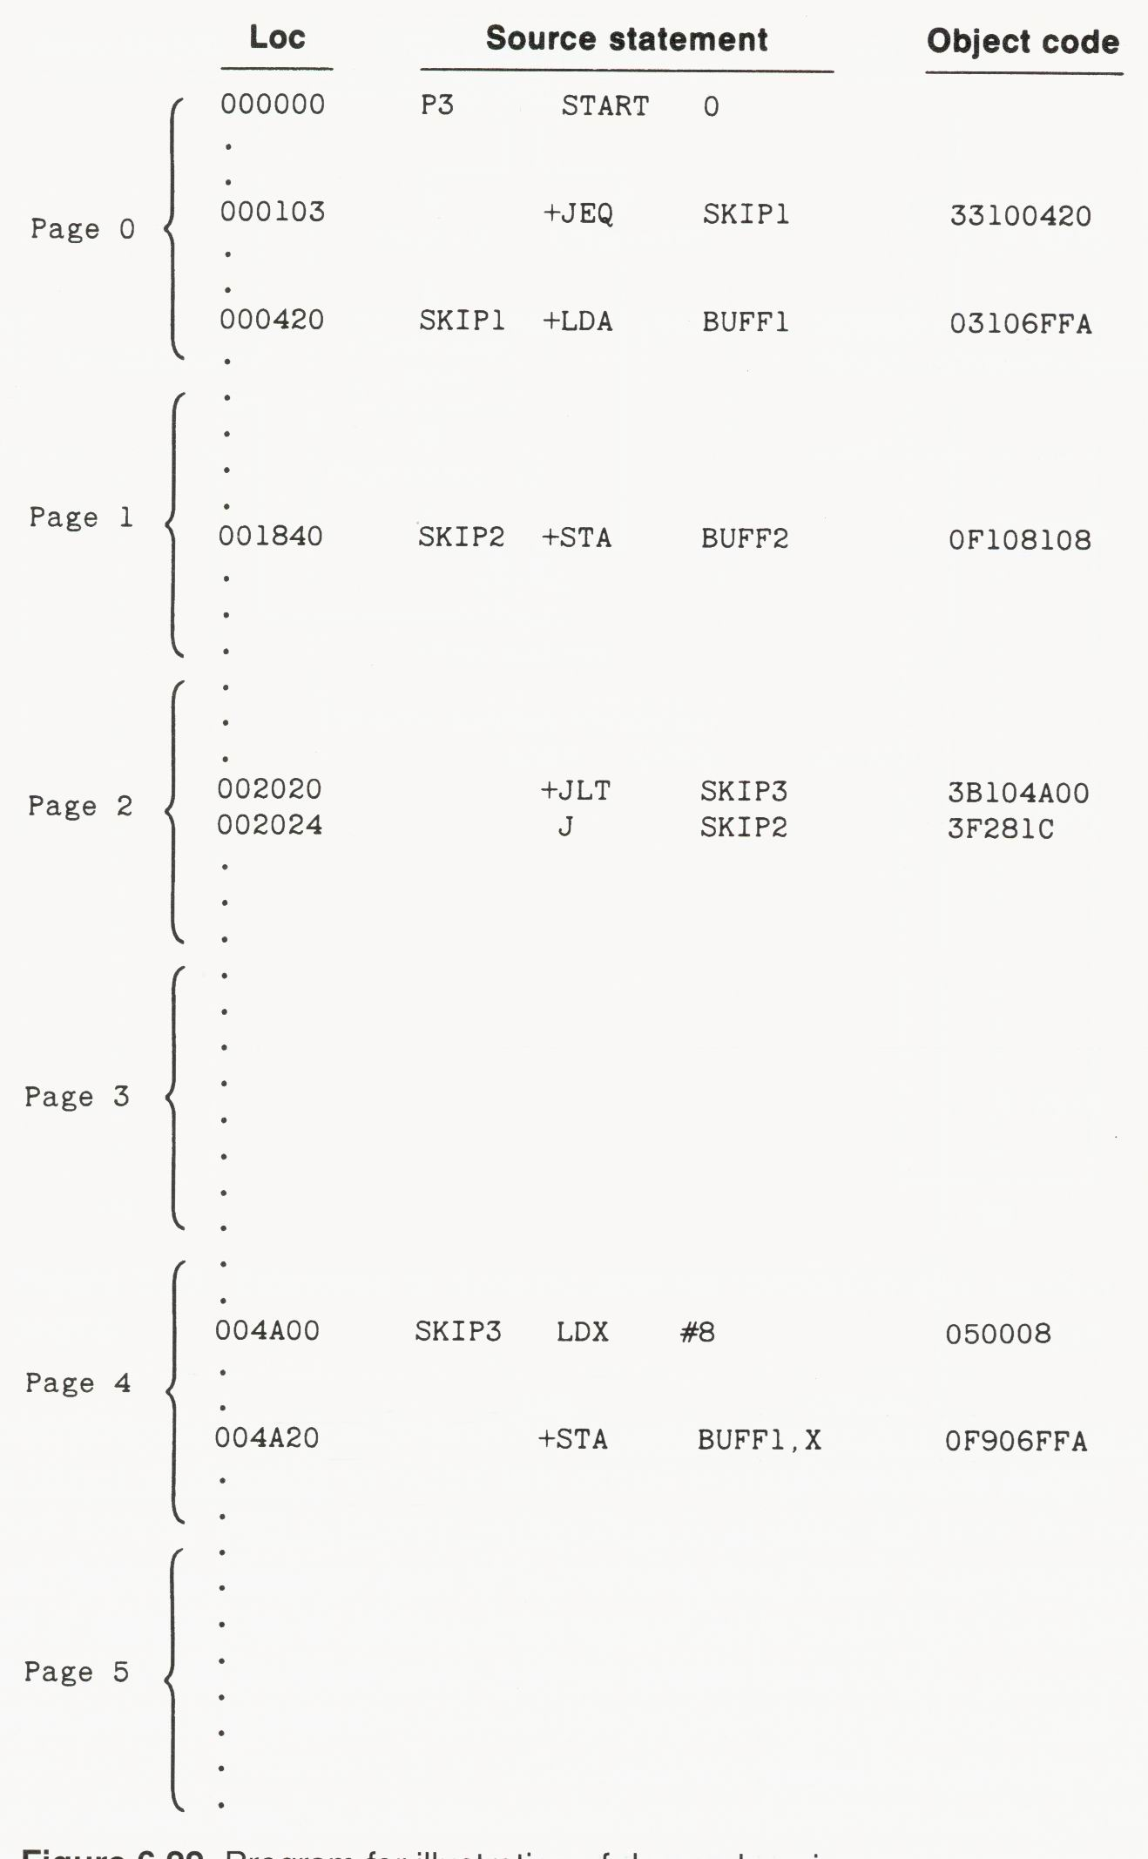
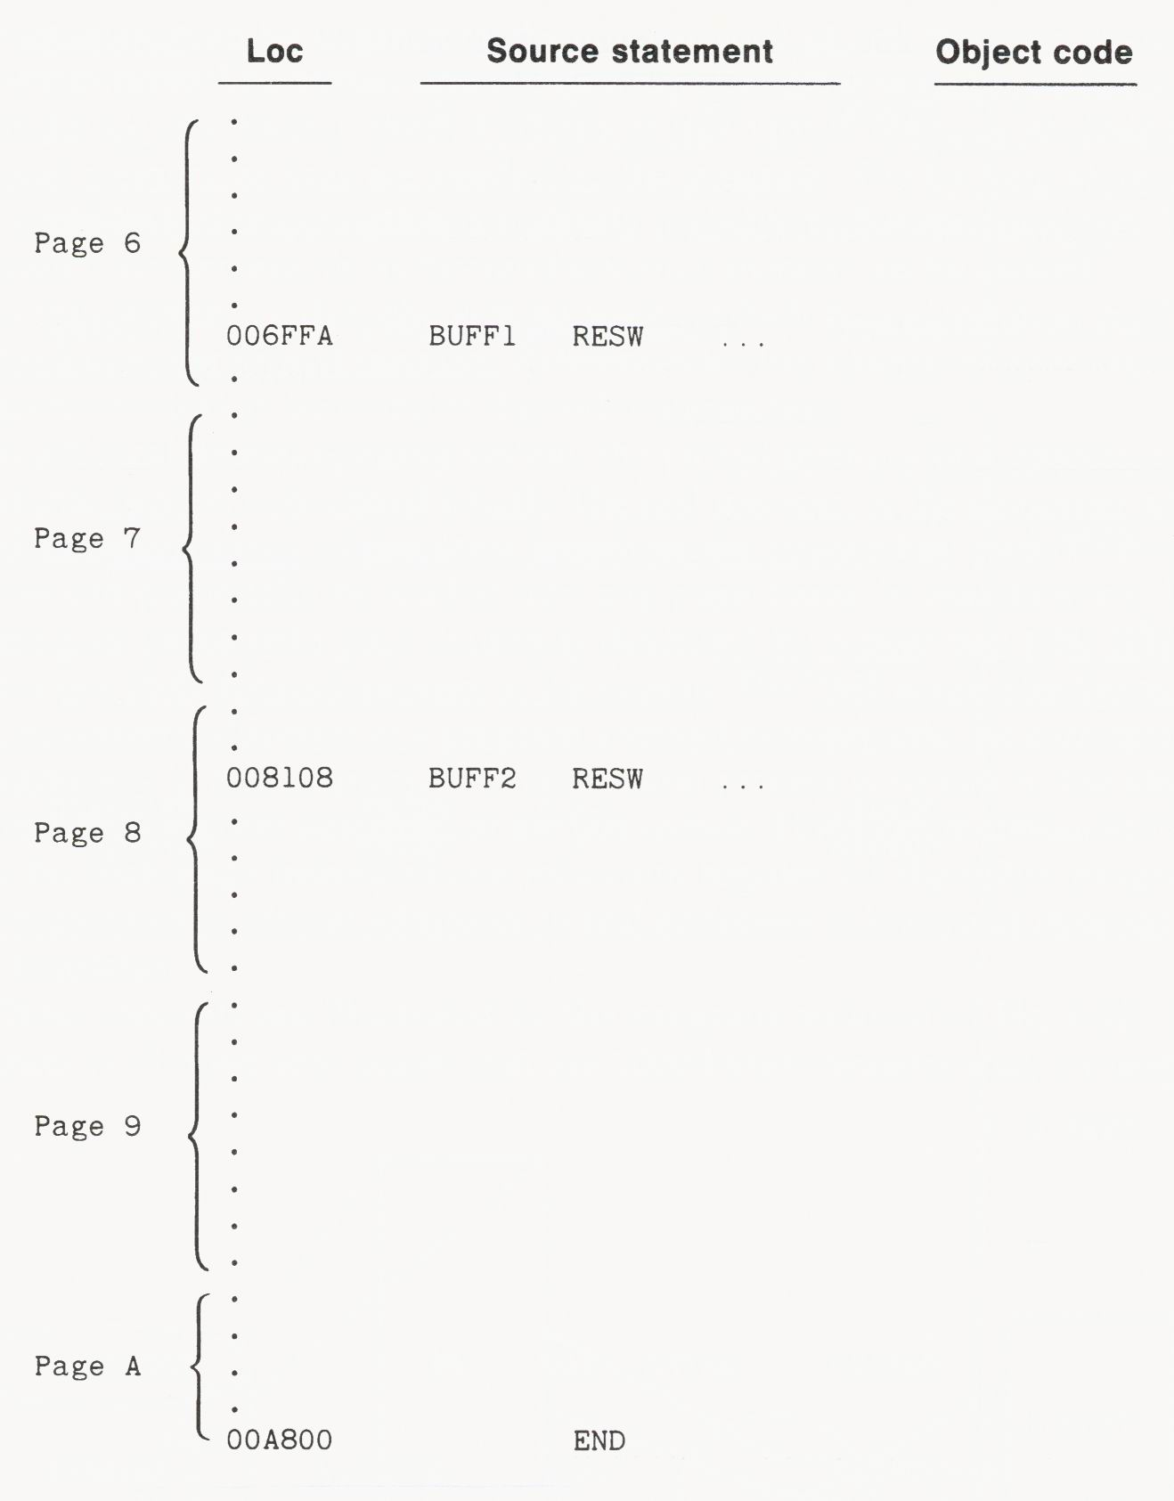
Program for Illustration of Demand Paging

Slide 37
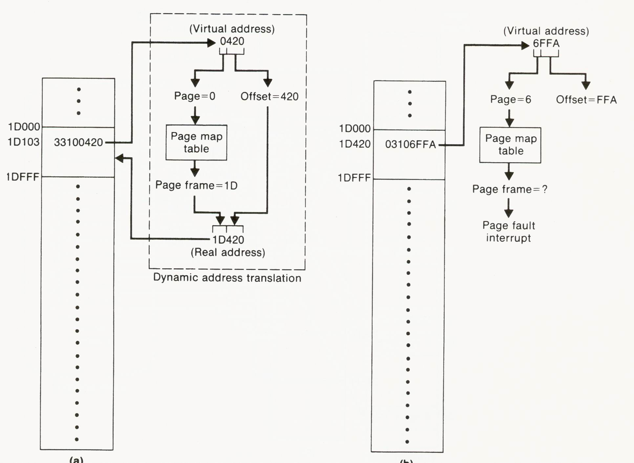
Example of Dynamic Address Translation and Demand Paging

Slide 38
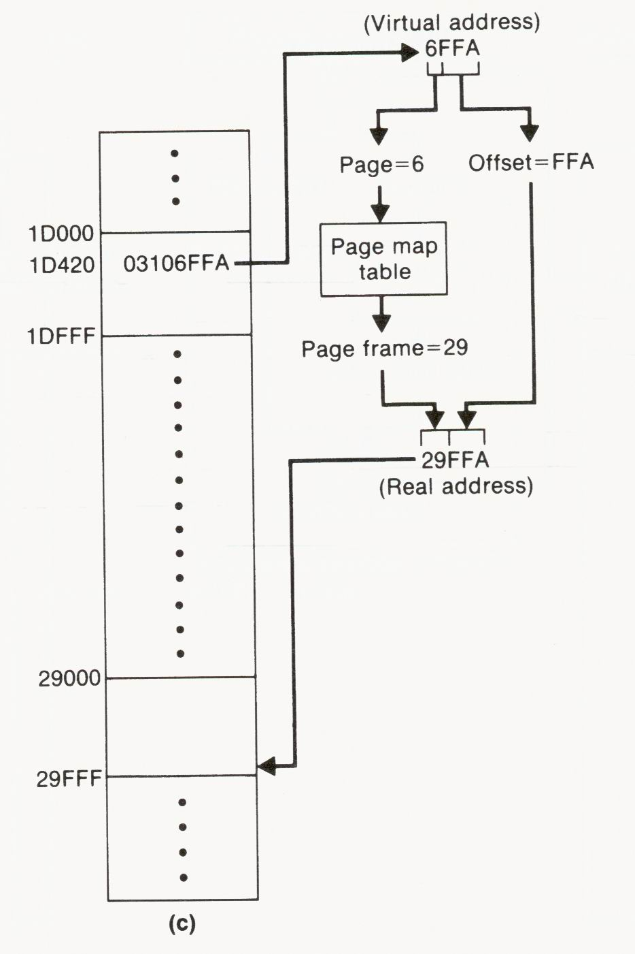
Example of Dynamic Address Translation and Demand Paging

Slide 39
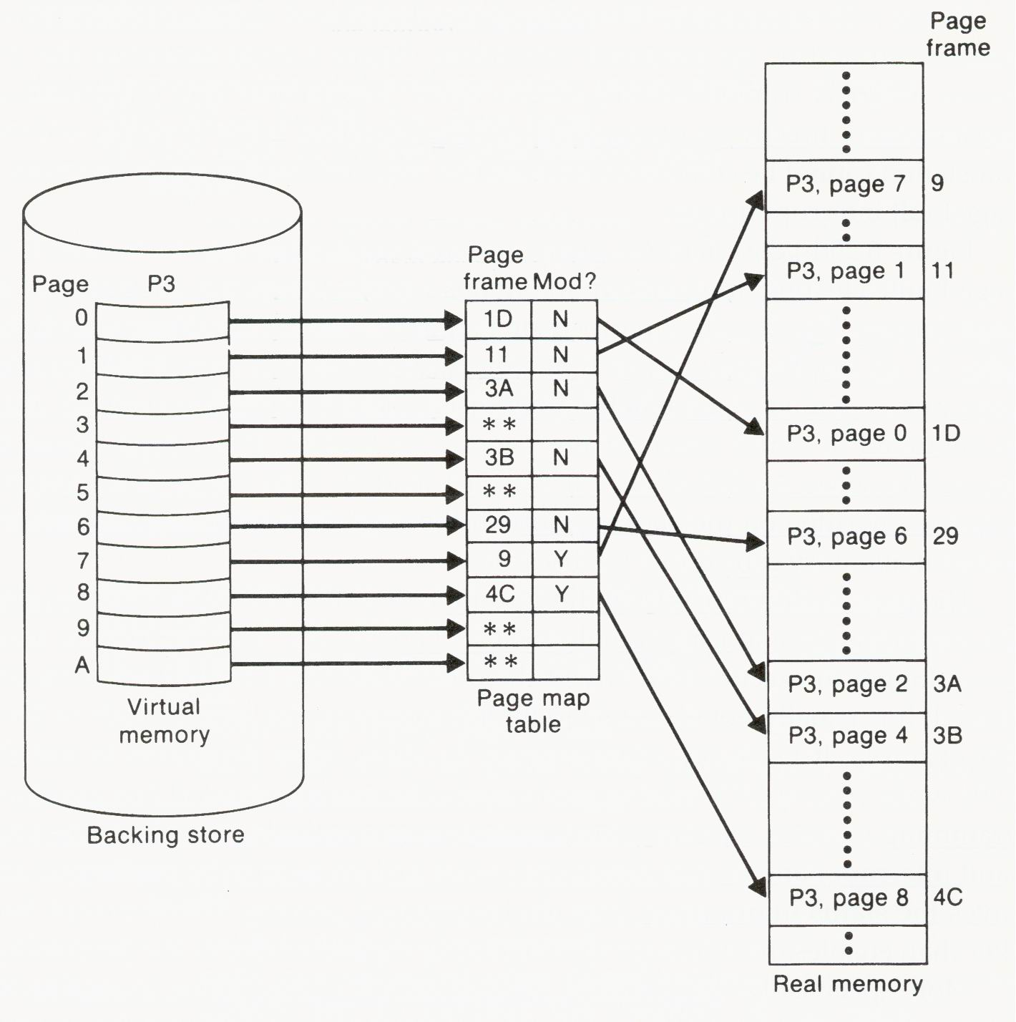
Virtual-to-Real Mapping Using a PMT

Slide 40
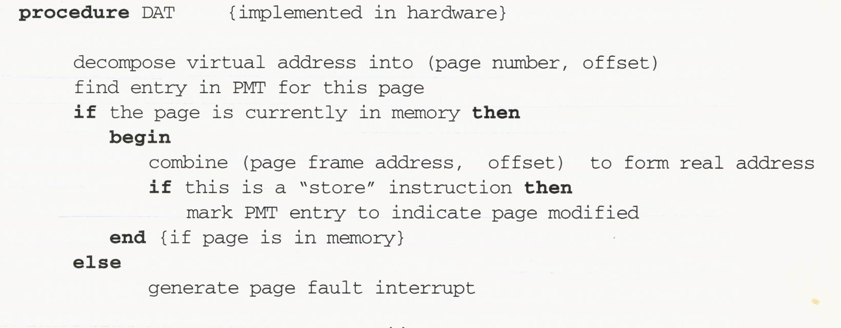
Algorithm for Dynamic Address Translation

Slide 41
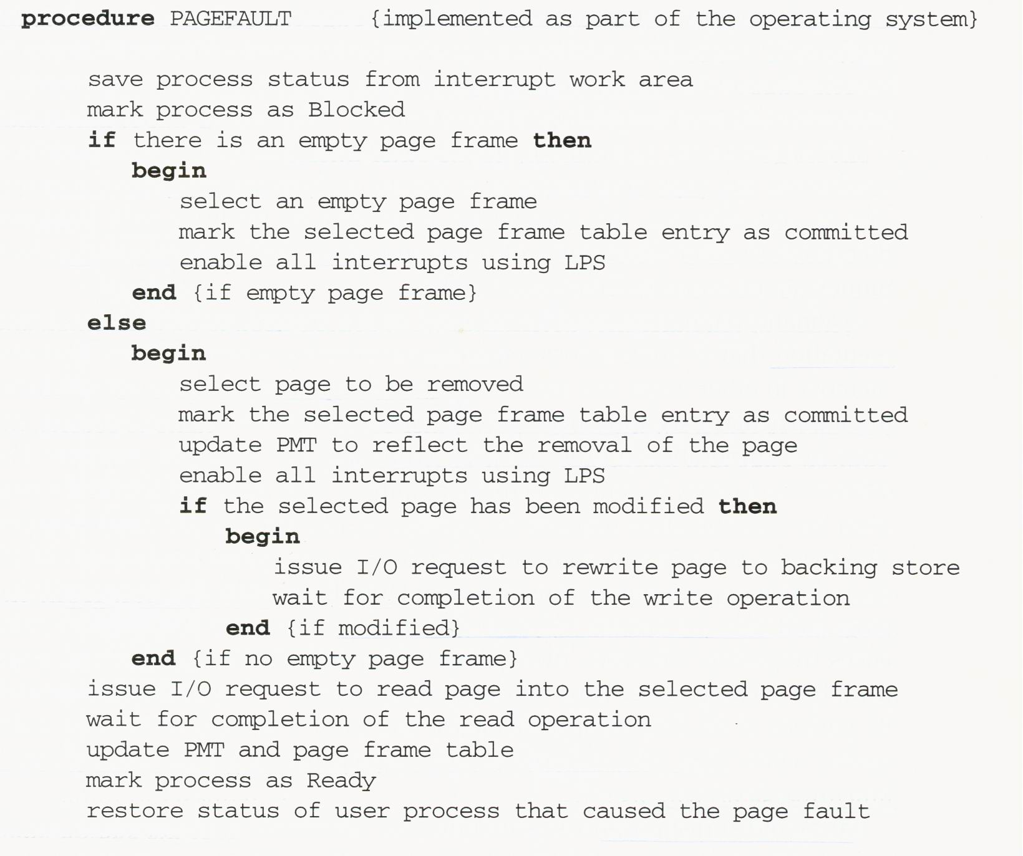
Algorithm for Page Fault Interrupt Processing
OS maintains a table describing the status of all page frames
Why?

Slide 42
Page Selection for Removal
Strategies:
  Least recently used (LRU) method
    Keep records of when each page is memory was last referenced and replace the page that has been unused for the longest time.
    Overhead for this kind of record keeping can be high, simpler approximations to LRU are often used.
  Working set
    Determine the set of pages that are frequently used by the process in question.
    The systems attempt to replace pages in such a way that each process always has its working set in memory.

Slide 43
Implementation of Page Tables
Method 1:
  Implement these tables as arrays in central memory.
  A register is set by the OS to point to the beginning of the PMT for the currently executing process.
  This method can be very inefficient because it requires an extra memory access for each address translation.
Method 2:
  Combine method 1 with a high-speed buffer to improve average access time.
Method 3:
  Implement the page tables in a special high-speed associative memory.
  This is very efficient, but may be too expensive.

Slide 44
Demand-Paging Systems
Advantages:
  Efficient memory utilization
    Avoid most of the wasted memory due to fragmentation associated with partitioning schemes.
    Parts of a program that are not used during a particular execution need not be loaded.
Disadvantages:
  Vulnerable to thrashing problem:
    The computing system spends most of its time swapping pages but not doing useful work.
    Consider a case:
      Memory reference: 1 μsec
      Fetch a page from the backing store: 10000 μsec
      Page fault rate: 1%
      Only about 1% of its time is for useful work.

Slide 45
Locality of Reference
To avoid thrashing, page fault rate has to be much lower.
It is possible because the locality of reference can be observed in most real programs:
  Memory references are not randomly distributed, but tend to be clustered together in the address space.
  This clustering is due to common program characteristics:
    Sequential instruction execution
    Compact coding of loops
    Sequential processing of data structures

Slide 46
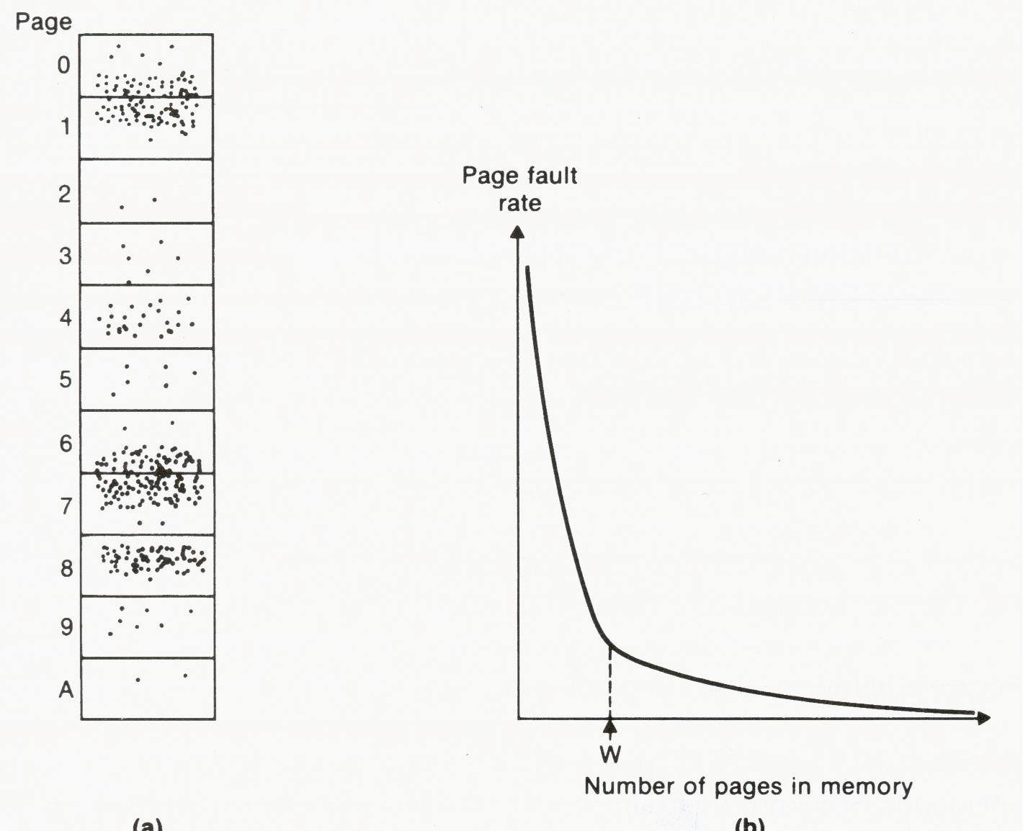
Localized Memory References and Their Effect on Page Fault Rate
thrashing
Working set of pages

